Slide 1
Restorative Practice Essentials
Mairangi Bay School
June 2024
Leane Carlson
Restorative Practice Facilitator

Slide 2
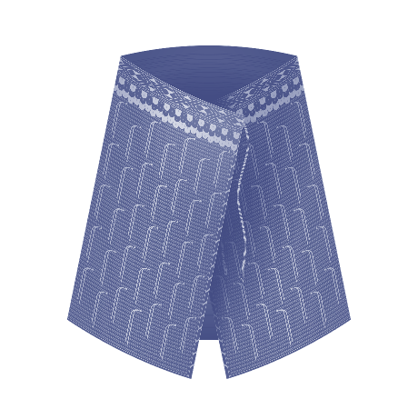
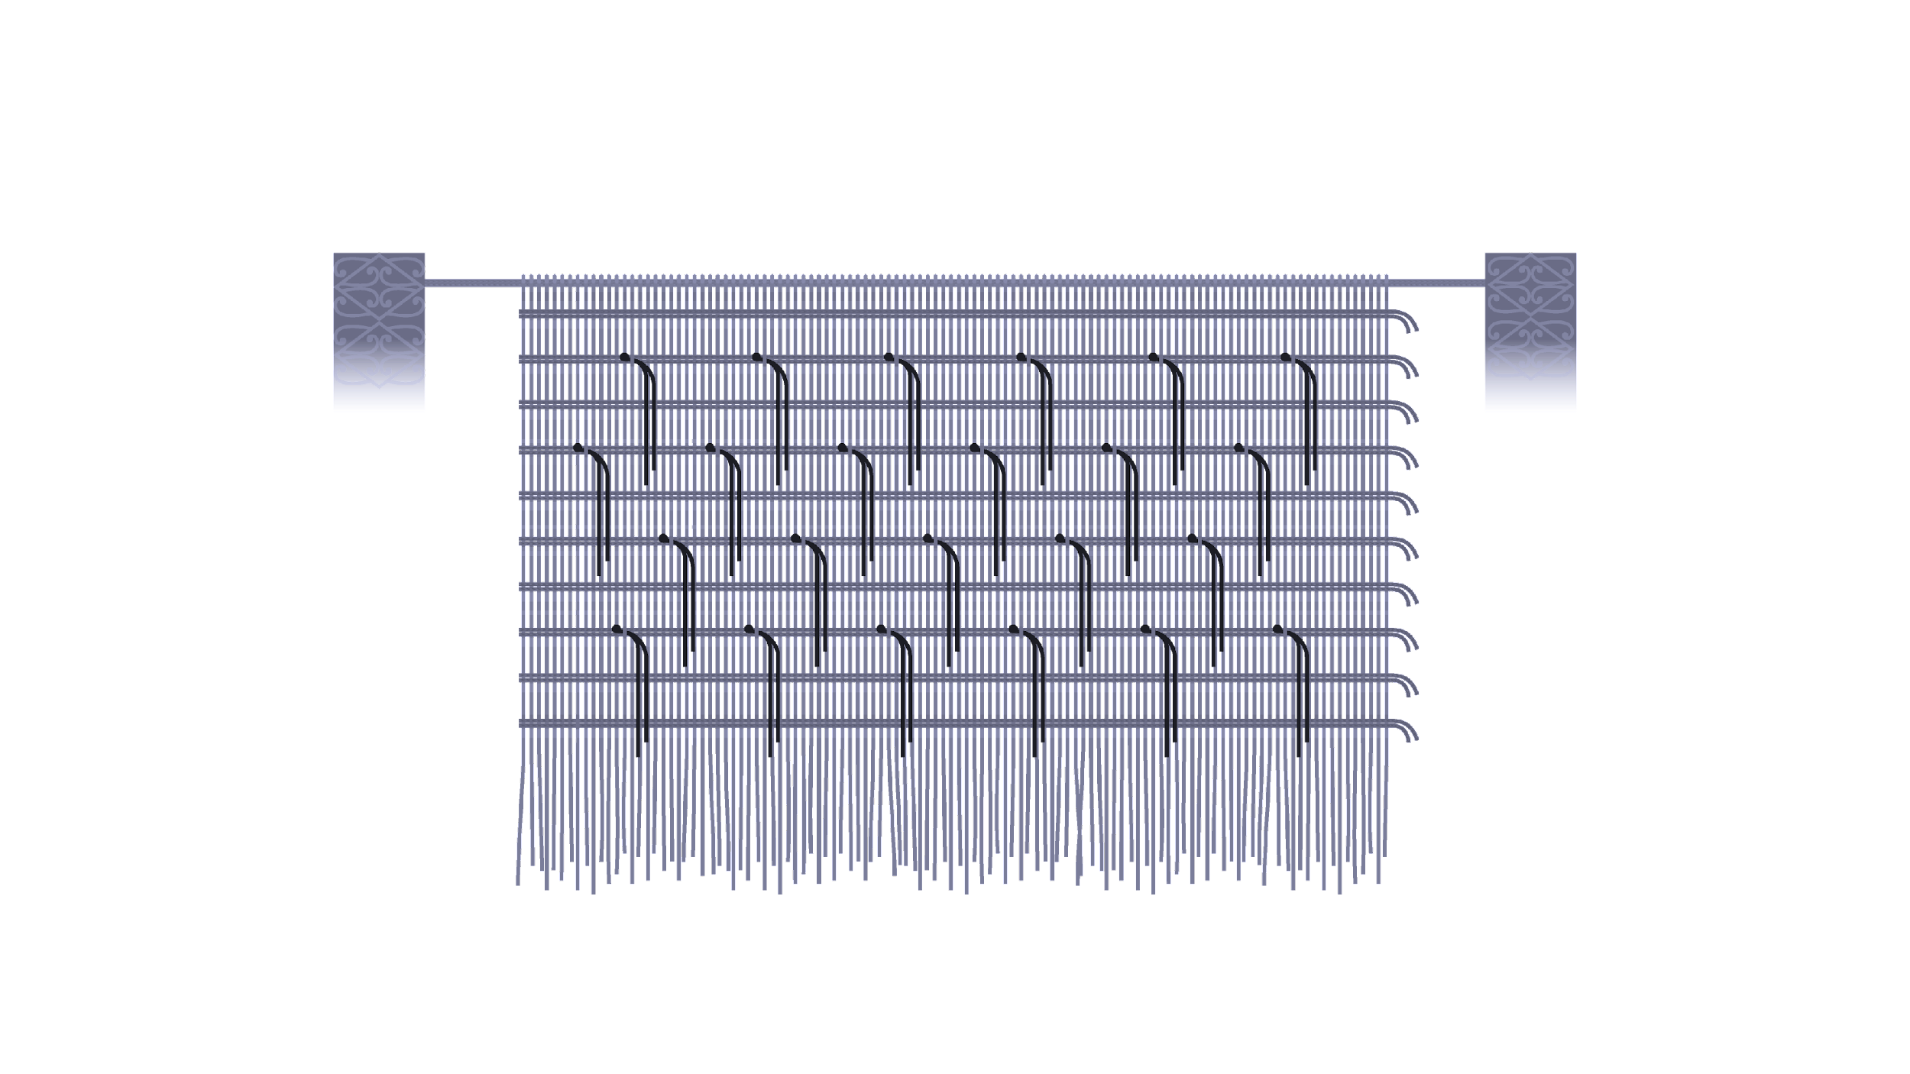
PB4L Restorative Practice Kaupapa
The preamble of te Tiriti o Waitangi reads:
“kia mau tonu hoki te Rongo ki a rātou me te Atanoho hoki".
Patu Hohepa speaks of "Atanoho" as the continued desire of the rangatira to maintain peace and tranquillity over our land.
“Atanoho” is based on the metaphor of a finely hand woven kākahu (cloak). Our PB4L Restorative Practice kākahu is embedded with key elements that lay the foundations for the way that our team will work alongside and support kura and schools, whānau and the wider community.
Te Aho Tapu: The sacred thread This is the first horizontal thread that is cast for the kākahu and sets the pattern for the way we will work with kura and schools, with whānau, hapū and iwi in partnership.
Our three threads that create Te Aho Tapu are, Te Tiriti o Waitangi, Restorative Practice Kaupapa and Ngā Pūmautanga (the values) of Te Whai Toi Tangata.
Te Aho Tapu
Whenu
Ngā Aho
Ngā Hukahuka
Ngā Aho: Multiple key educational documents and initiatives such as the New Zealand Curriculum, Te Mātaiaho, NELPS, Ka Hikitia, Action Plan for Pacific Education, Tū Rangatira, Educational Leadership Capability Framework etc.
Whenu: The core components of Restorative Practice are Essentials, Circles, Mini Conference and Formal Conference training. Other strands of the whenu include online professional learning opportunities for PCTs, Neuro Diverse, Restorative Leadership etc.
Ngā Hukahuka: The twisted threads that are woven in to the kākahu represent the unique elements and character of your school, such as your school vision and values, cultural narratives, localised curriculum etc.
This kākahu then becomes an authentic taonga (treasure) for each kura or school to care for and cherish.
Restorative Practice is based on a relational approach, which recognises that human beings exist in a world of relationships and that a person’s character is developed through their relationships with others. The underlying principle of the relational approach is that all people are entitled to enjoy respect, care and dignity.
PB4L Restorative Practice, Kete Book Two – Restorative Essentials p4

Slide 3
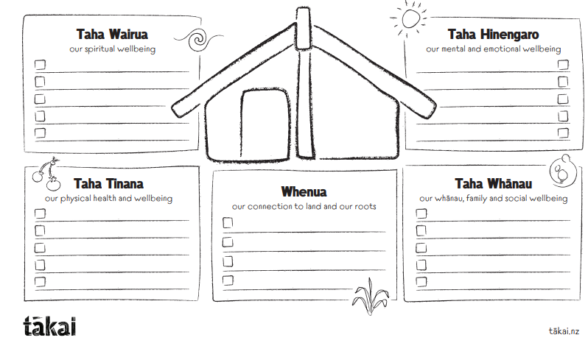
Mana Potential
WHARE TAPA RIMA
Durie 1984

Slide 4
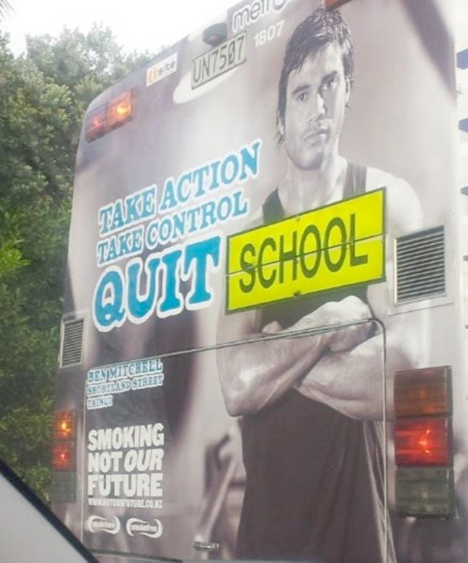
Myself | My Colleagues | Students
Seen on the back of a bus in Christchurch
What are the messages we unintentionally give?
Adult Conversations
An adult conversation as described by a Northland Secondary Principal.
An adult conversation is always:
Calm
Respectful
Listening to one another
Honest
Great to view:
Katy Hutchison – Restorative Practices to Resolve conflict / build relationships Rita Pierson – Every Kid Needs a Champion
Sala Tiatia - The Power of Words TED Youth@Christchurch
What I wish My Teacher Knew - Kyle Shwartz / TED Kyoto
A Conversation with Dr. Bruce Perry - Pathways to Resilience
The Barbershop where Men go to Heal | Matt Brown – YouTube
Podcast : I’ve Got Questions - Pio Terei and Kathryn Burkett

Slide 5
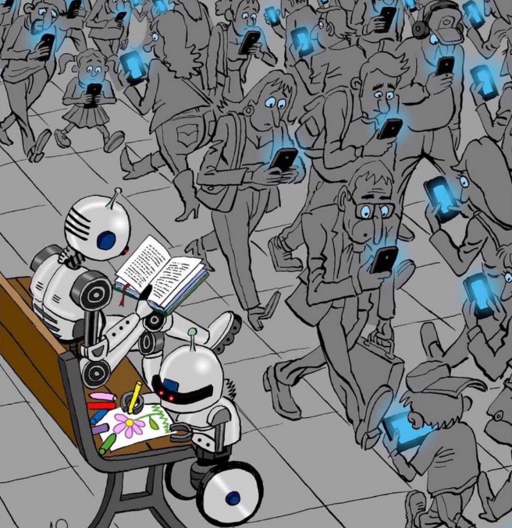
If you’re not modelling what you’re teaching… you’re teaching something different.
Hopkins
Relational Approaches Building a Relational Learning Culture
My strategies:
Others’ ideas:
Keeping the small things small RP ideas
Admitting our mistakes is an act of bravery
If you were part of the problem…..you are part of the solution.
The more we talk…..the less they talk.
A 7 second pause after asking a question holds space for all.
5

Slide 6
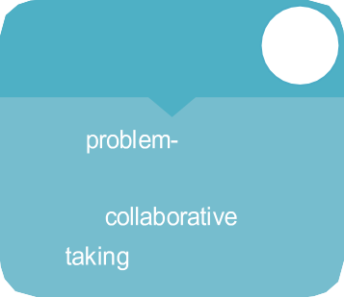
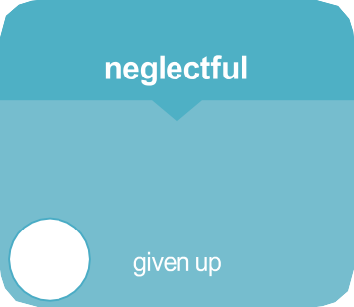
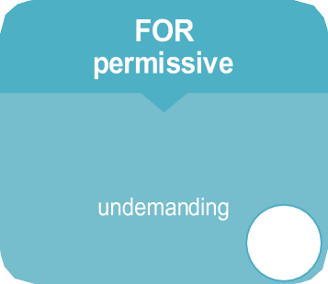
The Social Discipline Window
HIGH
WITH restorative
TO
solving respectful
win/lose
stigmatising
responsibility
STRUCTURES • LIMITS • EXPECTATIONS
NOT
indifferent unsafe lazy
protective
rescuing
excusing
LOW
HIGH
Adapted from Wachtel and McCol d, 2003 (adapted from Glaser, 1964)
The fundamental hypothesis of restorative practices is disarmingly simple: that human beings are happier, more productive and more likely to make positive changes in their behaviour when those in positions of authority do things with them, rather than to them or for them.
Wachtel
Punitive & Restorative Responses
adapted from Jansen / Matla n.d. (adapted from Zehr, 2002) – kete Book One – p.4
6

Slide 7
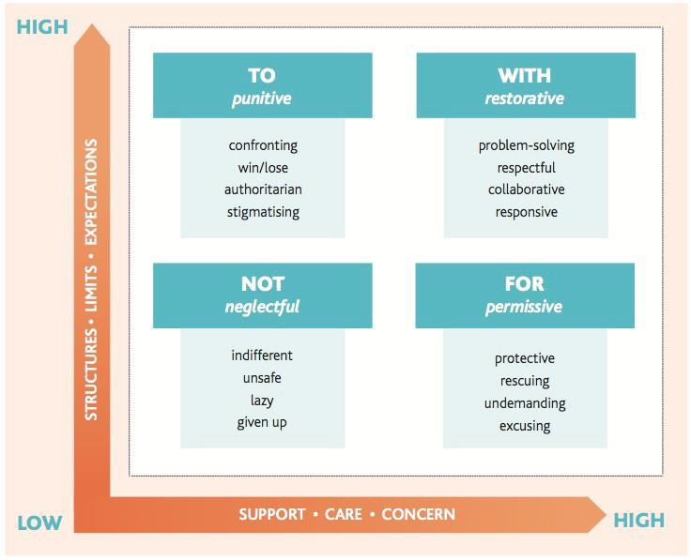
Ask versus Tell WARM
What happened?
Affected who?
Repair how?
Move Forward.
Tell
Ask
Two Guiding Principles
No more harm is caused.
The needs of those
involved in the incident
are met where possible.
Ignore
Answer
Adapted Jansen / Matla 2011
Adapted Jansen/Matla 2011
5 Steps of a Restorative Chat
Tell the story - Tell me what happened?
Explore the harm - Who do you think has been affected? In what ways?
Repair the harm – What do you think needs to happen to put things right?
Reach an agreement – So you’ve agreed to….
What will you do differently next time?
Plan follow-up – I will check in with you and the other person on……
‘The key is certainty rather than severity’. Bill Rogers
7

Slide 8
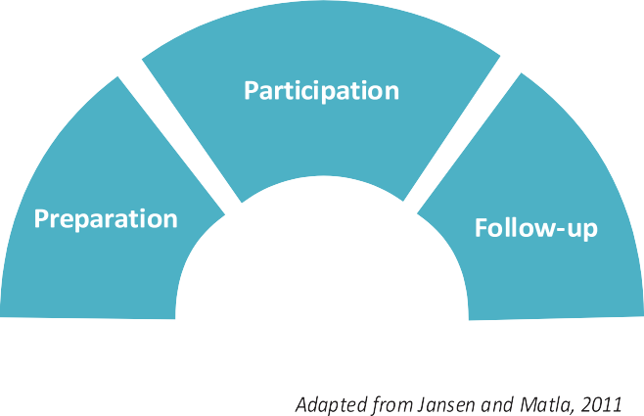
Own it – Fix it – Learn from it!
FIGURE 3: THE THREE PHASES OF PB4L RESTORATIVE PRACTICE
Preparation phase
Am I ready / are they ready?
Where is it best to have this conversation?
Participation phase
Is the conversation a dialogue not a monologue?
Calmly follow the steps of a restorative chat.
Tell the story, Explore the harm, Repair the harm, Reach an Agreement, Plan follow up
Follow-up phase
Check in- follow up on agreement
Further support & guidance to complete agreement if needed.
Ngā whakawhitiwhiti kōrero, me ngā pātai. Wonderings & Questions
Mahia i runga i te rangimarie
me te ngākau māhaki With a peaceful mind and a respectful heart,
we will always get the best results

Slide 9
Restorative Conversation Adaptations
Adapted Script Neuro Diverse
Early Years Script Adaptation
Own It – Fix it - Learn from it
I’m sorry / I apologise (name/s) _________
for _______ because it ___________ (affect).
Adapted from ‘The Early Years Restorative
Practices Script’ © Jane Langley

Slide 10
How restorative am I ?
Take a moment to reflect on the way you interact with people after an incident. Grade yourself on the scale below. 1. No 2. Sometimes 3. Usually 4. Always
 |  | 1. | 2. | 3. | 4.
1. | Do I check that all parties including myself are calm and ready to have the conversation? | ☐ | ☐ | ☐ | ☐
2. | Do I use a curious and warm tone with my questions, not accusatory? | ☐ | ☐ | ☐ | ☐
3. | Is the conversation respectfully away from an audience? | ☐ | ☐ | ☐ | ☐
4. | Do I listen, without interrupting? | ☐ | ☐ | ☐ | ☐
5. | Do we explore how the school values apply to the issue? | ☐ | ☐ | ☐ | ☐
6. | Do they understand the harm they have caused: who has been harmed and how? | ☐ | ☐ | ☐ | ☐
7. | Do I take responsibility for any part I might have played in what happened if that is a factor, acknowledge that and apologise/make amends etc? | ☐ | ☐ | ☐ | ☐
8. | Has the person who caused the harm, collaboratively problem-solved as to how they can repair the harm? (Or did the adult simply tell them what to do?). | ☐ | ☐ | ☐ | ☐
9. | Have I checked on the needs of the person who was harmed and have those needs been met wherever possible? | ☐ | ☐ | ☐ | ☐
10. | Is the plan agreed to, and have I offered to help with it if needed? | ☐ | ☐ | ☐ | ☐
11. | Did I check if the plan was followed through between the students / adults to repair the harm? | ☐ | ☐ | ☐ | ☐
12. | Do I handle all minors and some major issues/ incidents that occur in my class and the playground, myself? | ☐ | ☐ | ☐ | ☐
13. | Do I seek support when issues get tricky for me, following the school system to ensure the harm is addressed? | ☐ | ☐ | ☐ | ☐
14. | Do I enter the incident and response into the SMS as required at the appropriate level of harm? | ☐ | ☐ | ☐ | ☐
15. | If the same behaviour is repeated often and doesn’t change, have I reflected on the archway to consider where the process could improve? | ☐ | ☐ | ☐ | ☐
What do you want to strengthen?
Reflect on a goal from above that will help strengthen your Restorative Practice skills.
10

Slide 11
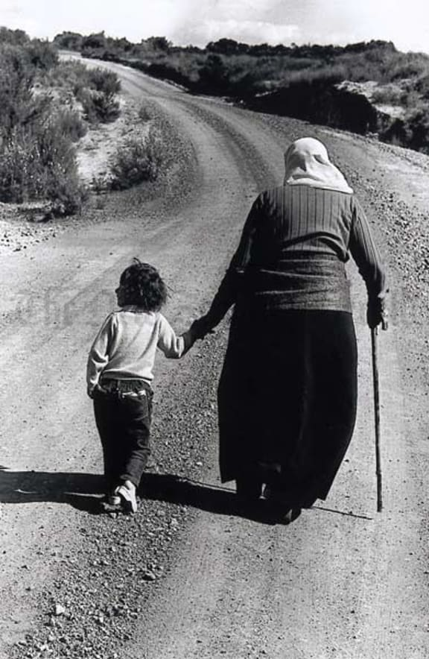
Take care of our children.
Take care of what they hear,
Take care of what they see,
Take care of what they feel.
For how the children grow,
so will be the shape
of Aotearoa.
Dame Whina Cooper
Photographer
Michael Tubberty
PB4L Restorative Essentials Staff Training day
Te Whai Toi Tangata, University of Waikato
in partnership with the Ministry of Education
For further support contact:
Leane Carlson leane.carlson@waikato.ac.nz
Kua raranga tahi tātou, he kākahu mo āpopo
Together we weave the cloak for the future

