Slide 1
Introducing and exploring the Science of Learning 2024 teacher-only day resource

Slide 2
Building understanding
Exploring the Science of Learning can help us:
build a shared understanding of how people learn - biologically, developmentally, cognitively, culturally, emotionally, and socially
consider how that understanding can strengthen teaching and learning
establish a common language for teaching and learning.
Image from: Vecteezy
Notes:
The aspects covered in this slideshow – including the videos and resources within – are an introduction to the Science of Learning. They are not comprehensive, instead representing a subset of the broader notion of the Science of Learning.

Slide 3
Activating prior knowledge
What do you know about the Science of Learning?
Discuss the question in pairs.
Find another pair and add to your understanding.
Find another pair and come up with a sentence that describes what you know about the Science of Learning.
Share your sentence with the whole group.
OR
Make a word cloud - what words or phrases do you connect to the Science of Learning?
Notes:
Option 1: Accessing prior knowledge – 5-10 minute activity
Option 2 – make a word cloud, either using an online tool, or using post-it notes

Slide 4
The Science of Learning Webinar
Watch the video to 15:48
Dr Nina Hood, Founder of the Education Hub, will give you a quick introduction to the science of learning, what the research on the science tells us about the cognitive processes that inform the learning process, and the implications of this on pedagogy and curriculum.
Notes:
Watch to end of Nina’s section
After this, you could revisit the activity on slide 3 and reflect on what you have learnt, or do the activity on slide 5.

Slide 5
Unpacking the Science of Learning
Discuss the video and share your thoughts.
Decide on:
3
2
1
pieces of information from the video that are significant in your context.
things that interested or surprised you.
question that you have about the Science of Learning.
Image from: Vecteezy

Slide 6
Using the Science of Learning
Match the Science of Learning terminology to its definition, and the ways that you can implement it in your practice.
Terminology
Definition
How to implement
+
+
Spaced
practice
Practicing over time to provide opportunities to retrieve key information
Plan to revisit content after a gap in time

Slide 7
In this section, you can see some examples of explicit teaching strategies

Slide 8
Worked Example Effect
What is it?
Teachers use worked examples when they model how students can use step-by-step approaches to solve problems and/or sequentially perform a skill.
Modelling how to solve processes and asking students to explain their understanding of the process helps reduce cognitive load.
To scaffold students' learning, the worked example can gradually fade away – starting with showing more details and then progressing to showing less.
Be aware:
There is evidence this method is successful for learning new skills, but not for consolidating already learned skills.
Adding unnecessary guidance to existing schema increases cognitive load for an expert in a domain as they have to integrate the instruction with their existing expert knowledge
Notes:
Further to the “Be aware” note:
Adding unnecessary guidance increases cognitive load for an expert in a domain, as they have to integrate the instruction with their existing expert knowledge.

Slide 9
Worked Example Effect
128 x 8 =
128 x 8 =
100 x 8 = 800
20 x 8 = 160
8 x 8 = 64
800
160
+ 64
1024
1
213 x 8 =
213 x 8 =
200 x 8 = 1600
10 x 8 = 80
3 x 8 = 24
1600
80
+ 24
Finish the final step
424 x 8 =
424 x 8 =
400 x 8 = 3200
20 x 8 = 160
4 x 8 = 32
+
Finish the problem
125 x 8 =
125 x 8 =
100 x 8 =
20 x 8 =
5 x 8 =
413 x 8 =
413 x 8 =
Finish the
problem
Finish the problem
Notes:
By breaking 128 into 100 (one hundreds), 20 (two tens) and 8 (8 units) and multiplying each by 8 we are breaking down the problem. Colours activate prior knowledge about place value and partitioning.
In each example there is less scaffolding. As the support gradually fades students become more independent, applying the same method that they have learned to similar problems.

Slide 10
Worked Example Effect Reflection Activity
Consider how worked examples can be used…
E.g., mathematical operations, conjugating verbs, negating sentences in different languages, finding unknown values in geometry, calculations in chemistry/physics, interpreting what each step of a sequence of code performs.
Have a go at producing partially solved examples to help scaffold learning for your students.
Consider how you might gradually fade the support as proficiency develops.
You might try using a worked example with a deliberate mistake

Slide 11
Presentation of Materials – Dual Coding
What is it?
Using two forms of representation to teach new ideas helps stimulate verbal and non-verbal cognitive pathways.
Labelled diagrams, audiovisual presentations and graphic organisers help students engage with new learning.
Be aware:
Limiting the presence of distracting and unnecessary information can help manage cognitive load and reduce extraneous load.
Ensuring the representations are complementary, reinforcing the same learning is required.

Slide 12
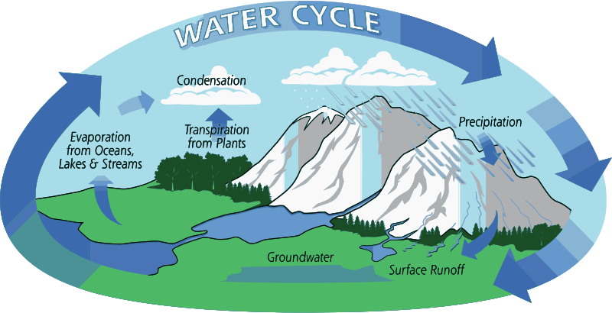
Presentation of Materials – Dual Coding
Instructional prompt:
Use the image to describe what is happening in each of the processes labelled.
Explain why this is called a cycle?
Image from: Open Clipart

Slide 13
Concrete Before Abstract
What is it?
Mathematical symbols represent processes or concepts that learners may need conceptual exposure of to gain a deep understanding.
Using concrete materials may help develop this understanding.
Be aware:
Teachers should have a clear rationale for their use of concrete examples.
Research shows manipulatives are more effective when they closely represent the mathematical concept they are used for.
The ultimate aim is to build understanding and automaticity, and therefore reduce learner reliance on a manipulative.
Notes:
Making it Count: Teaching Maths in Years 1 to 3 (ero.govt.nz)
https://evidence.ero.govt.nz/documents/making-it-count-teaching-maths-in-years-1-to-3
Ask the Cognitive Scientist: Do Manipulatives Help Students Learn? (aft.org)
https://www.aft.org/ae/fall2017/Willingham
Animations need narrations: An experimental test of a dual-coding hypothesis. (apa.org)
https://psycnet.apa.org/record/1992-07871-001
Please note these links must be copied & pasted into your browser

Slide 14
Concrete Before Abstract Example
Student task:
Use the place value discs and one frames to solve 0.7 + 0.7
Extension: Rewrite the equation using fractions
0.1
0.1
0.1
0.1
0.1
0.1
0.1
0.1
0.1
0.1
0.1
0.1
0.1
0.1
Notes:
Student has previously used place value discs with wholes numbers and representing decimals. These are now used to add decimals. Writing the equation of as a fraction might connect to prior knowledge of decimal fraction relationships.

Slide 15
Concrete Before Abstract – Reflection activity
Discuss what types of manipulative or concrete representations have you used with success in your teaching.
How have you used your knowledge of the cultures and identities of your learners to use familiar concrete examples that reduce cognitive load for diverse learners?
How might dual coding or interleaving work to support a concrete to abstract approach?

Slide 16
Emotions and learning
In the webinar, Nina Hood says:
“We need to be aware of students' emotions at any given time because that's going to influence their ability to learn and memorise new information. We know that students need to feel a sense of belonging and connection to where they are, to be able to effectively engage in learning.”
Discuss:
What strategies have you used to create a safe and nurturing environment for your learners? What does this look like, sound like, feel like in your context? How did you know your strategy was successful?
Ākonga learn best in positive learning environments that nurture their languages, identities, cultures, social, emotional, and cognitive skills. How could a students’ language, culture and identity impact how they move from surface learning to deep learning?
Explore in small groups exploring approaches to supporting social and emotional learning and resources you may use (Example: Oho and Ata).
Notes:
You might want to visit these pages to read more for discussion:
The brain, emotions and learning – THE EDUCATION HUB
https://theeducationhub.org.nz/the-brain-emotions-and-learning/
Ata and Oho within Social sciences – Te ao tangata
https://newzealandcurriculum.tahurangi.education.govt.nz/ata-and-oho-within-social-sciences---te-ao-tangata/5637200835.p
The Mana Model – Melinda Webber
https://www.giftedreach.org.nz/archives/The-Mana-Model-Melinda-Webber.pdf

Slide 17
Unpacking the Science of Learning
Based on what you’ve learnt, split into groups
and answer these questions:
1
4
How do learners
understand new ideas?
How can you apply the Science of Learning in your context?
2
5
How do learners retain new information?
What are common misconceptions about how students think or learn?
3
6
How does learning transfer to new situations in or outside the classroom?
What motivates
students to learn?

Slide 18
Reflecting on how to use the Science of Learning
How can an understanding of the Science of Learning help you to:
give practical effect to
Te Tiriti o Waitangi?
have high expectations for all?
hold a broad view of success?
motivate and support the aspirations of ākonga?
be inclusive of languages, cultures and identities?
Image from: Vecteezy
Notes:
Possible alternative questions from Education Hub:
Do I fully understand how cognition works?
How do I ensure I activate students’ prior knowledge when introducing a new topic or skill?
Do I build practice into my lesson sequence?
Is the feedback I provide my students specific, task-focused and focused on improvement?
How do I feed into my students’ self-beliefs about their intelligence?

Slide 19
Structured literacy approaches from a science of learning perspective

Slide 20
Activating prior knowledge
What do you know about the structured literacy approaches?
Discuss the question in pairs.
Find another pair and add to your understanding.
Find another pair and come up with a sentence that describes what you know about the structured literacy approaches.
Share your sentence with the whole group.
OR
Make a word cloud - what words or phrases do you connect to structured literacy approaches?
Notes:
Option 1: Accessing prior knowledge – 5-10 minute activity

Slide 21
What is the Science of Learning?
What is a structured literacy approach?
For the purpose of reading and writing, the elements of structured literacy approaches include:
phonemic awareness and phonics
fluency
comprehension,
oral language
vocabulary
syntax
and text structure

Slide 22
What is a structured literacy approach?
In groups, discuss the terms from the previous slide and check that you all feel you understand them.
Then create a mind map or plan to show either:
how they are connected
how each is important to how you support students to develop literacy in your classroom.
phonemic awareness and phonics
fluency
comprehension,
oral language
vocabulary
syntax
text structure

Slide 23
What is your starting point?
Consider where you feel you are in your journey to understanding and applying structured literacy approaches.
Absolute beginner
Somewhat competent
Proficient
Expert
Remember – there’s no right/wrong answer!!!
Notes:
This could be shared in small groups or with a partner, or on a word cloud, or by physically lining up across a space from beginner to expert.

Slide 24
What is the Science of Learning?
Literacy and the Science of Learning
The science of learning is the study of how people learn - biologically, developmentally, cognitively, culturally, emotionally, and socially.
If we understand how people learn, we can improve teaching and learning.
Changes are being made to literacy learning and teaching that reflect the science of learning.
Image from: Vecteezy

Slide 25
Webinar: Structured literacy and the Science of Learning
Watch the webinar from 15:50 to end
Associate Professor Alison Arrow, University of Canterbury, explains how the science of learning can be applied within a structured literacy approach.

Slide 26
Reflection and discussion
Discuss the video and share your thoughts.
Decide on:
3
2
1
pieces of information from the video that are significant in your context.
things that interested or surprised you.
question that you have about structured literacy approaches in the context of the science of learning.
Image from: Vecteezy

Slide 27
What is the Science of Learning?
What is a structured literacy approach?
Structured Literacy Approaches (SLA) include explicit instruction that follows a gradual release of responsibility.
SLA teaching structures learning from simple to complex by following a scope and sequence, which sets out what is taught and the order in which it is taught. Phonics scopes and sequences are more well known, but they apply to other aspects of literacy too.
Instructional decision making is driven by what teachers notice and recognise their learners doing. This happens informally as well as using formal assessment tools.
Lessons are structured and build on what has been taught previously, and lead into what will be taught next.
Teachers give feedback to ākonga immediately so that incorrect assumptions aren't embedded into their memory.

Slide 28
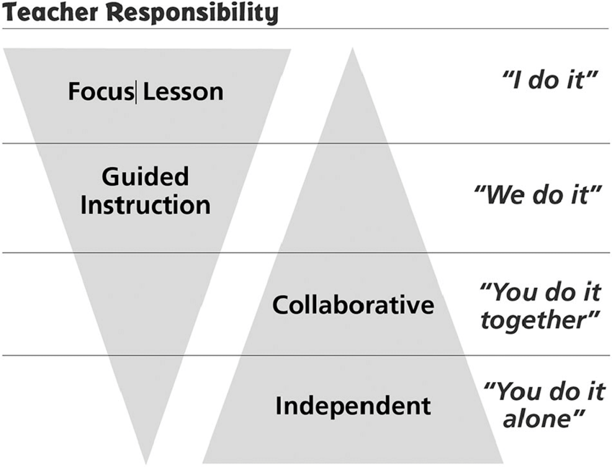
Lesson structure
Both the teacher and the learner are active participants in the explicit teaching process.
The lesson sequence begins with revision and then moves through “I do”, “We do” and “You do” phases that transfer responsibility from the teacher to the learners.
Literacy weaves across all learning areas. How could you apply this process to another area of the curriculum?
Notes:
Using the diagram, how do you see this in your teaching practice/lesson?
Once we have decided what needs to be learnt and identified the smallest element to teach to reduce cognitive load, we move on to the actual lesson itself.
The scope and sequence provides some structure around what is learned, but the lesson itself is structured to support learning too. This structure reduces the extraneous load which comes through learners thinking about other aspects of the lesson instead of focusing on the learning. They know at each part of a lesson what is expected of them and what they should be focusing their attention on. The structure is based on Fisher & Frey’s release of responsibility model and Bryan Byrne’s division of labour model. The division of labour means that as the teacher provides the initial new learning to be encoded, as learners apply and use that new learning, and strengthening that learning, then the teacher reduces the amount of support. The division of labour for learning shifts from the teacher to the student.
You can contrast this to the traditional guided reading, especially if used with round robin or popcorn reading. When there is a less structured approach the learner may do the book walk with the teacher, but when it comes to learning they are left to work it out as they read. This is then impacted by the other thinking they are engaging in, such as “am I next?” “what is that word?” “how come they know that word?” “what page are we on.” Being left to work out how to read a text, before the teaching is given, can create a sense of helplessness and anxiety.

Slide 29
All teachers are teachers of literacy
Literacy teaching is not just the responsibility of primary teachers or of English teachers.
For example:
PHOTOSYNTHESIS
If it is a word students need in your subject, then you need to explicitly teach it.

Slide 30
A lesson typically starts with some revision
Revision:
allows new learning to link to previous learning
provides practice of previous learning.
Discussion:
How do you link new learning to previous learning in your classroom? What activities are useful for eliciting prior knowledge?
How do you practice previous learning in your classroom?
How do you make practice fun?
Notes:
As will be familiar to teachers, a structured lesson will start with revision and review. What is included in the revision is the prior learning that will be reinforced or practiced during the course of implementing the new learning. The purpose of this is two-fold. Firstly, it activates the long-term memory becomes primed to draw on existing learning. We prompt for the retrieval of existing knowledge. This includes cultural knowledge and knowledge of languages other than the language of instruction.
For the example of learning to read, if a learner is ready to learn about letter-sound correspondences because they have been reminded about what they learned about them already, then they are ready to draw on that existing learning and relate the new learning to it. Secondly, it provides spaced and retrieval practice of previous learning, thus reinforcing what was already learnt.

Slide 31
Focus of the lesson (I do)
‘I do’ involves explicit teaching and modelling of new learning in manageable amounts to reduce extraneous load.
Discussion:
What is your understanding of “teacher talk”?
What could explicit teaching and modelling involve?
What is your understanding of ‘extraneous load” in teaching and learning?
How can you be sure that ākonga are actively learning?
Notes:
Explicit instruction begins with explicit teacher talk that supports the encoding of the new knowledge into long-term memory.
Explicitly teaching and modelling in manageable amounts could include:
sharing the learning purpose, based on diagnostic assessment or observation, by being specific and succinct about what is being taught
using multiple modes and representations. For example, written text and spoken words or handwriting, magnetic letters and texts to learn phoneme-grapheme correspondences
explaining and describing
using think-alouds to model the new knowledge. For example, “Let’s segment the word phone. I see the letters ph at the start of the word and I remember that it makes the sound /f/”.
Students do not need to spend cognitive effort trying to work out what they are learning as it is clearly stated and not cluttered by trying to pick what the teacher expects to be learned out of the learning sequence.
For the ‘sh’ example, instead of asking children, ‘what's this sound?’ or, ‘what are these letters?’ or, ‘what sound do they make?’, teacher talk involves actually telling them instead. We will tell them, ‘instead of making their individual sounds, the ‘s’ and ‘h’ together make the /sh/ sound.’ We're not leaving it to chance that they will work it out as they practice reading new text. They're actually being taught what it is, and they know how to use it. Through the provision of explicit teacher talk about what new learning is and how to apply it, learners can develop self-efficacy as they develop the knowledge of what they need to be able to do to read new and unfamiliar words without support.
We can contrast this to the traditional guided reading approach to teaching reading in which the teacher often identifies the new learning through noticing what was challenging while reading a piece of text, for example “you found the words shed and dash hard to read, so let’s look at them.” Teaching with the instruction after the challenge means that the schema is not activated and the amount of effort a learner needs to put into both encoding and retrieving reduces the learning we wanted.

Slide 32
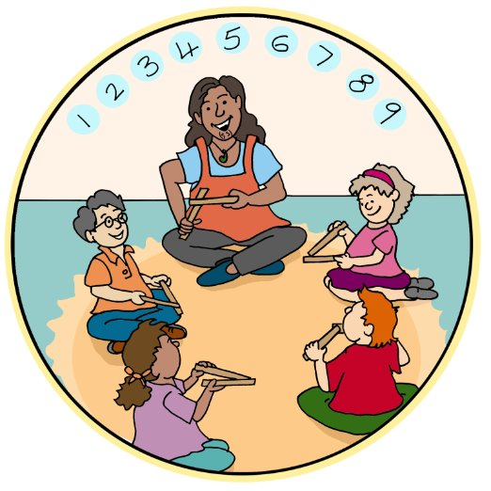
Guided practice (we do)
‘We do’ involves the teacher guiding student practice and skills development.
It may involve:
worked examples to reduce the extraneous load and enable
a focus on the germane load (effort)
reading and spelling to increase cognitive flexibility.
Discussion:
In pairs or groups, create a sentence for each word in italics
that shows you understand the meaning.
What else could you do to guide student practice and skill development?
Notes:
In the guided practice part of the lesson, or the, ‘we do’. The students practice the new learning alongside the previous learning that they've done. This is where learners engage with this new learning in slightly more challenging contexts.
So they're retrieving from their long-term memory, their previous learning, and that's beginning to encode the new learning as they practice it. And we do this practice through worked examples. For learning to read, the worked examples are opportunities for students to read and to spell short words that contain the new learning. We might start off this practice or this worked example by recalling previous learning, so we might practice the word spelling and reading the word ‘ted’, which contains all previous learning just to reactivate that schema.
But then we add in the new learning. We might then say, ‘can you spell the word ship?’ The ship has /sh/, the new learning, but also the previous learning of the short vowel ‘i’ and the consonant ‘p’. So we're putting old and new learning together. Now we're reducing the extraneous load on their working memory, because we're not asking them to read text at the same time, we just focused on the words that we're learning and then the sound patterns that we're learning and not then putting in place other words around it through the use of connected text.
Because we're also asking them to do reading and spelling and not just one or the other, we're improving cognitive flexibility. They're able to apply this new learning to both reading and spelling, not just to reading, because they're only practicing it and reading.
Guiding practice and skill development could also include:
Prioritising engagement and providing ways for every student to participate. For example, every student responds at the same time such as thumbs up, down or sideways
Providing opportunities for students to show understanding in multiple ways, such as answering questions, elaboration or using new vocabulary in different contexts
Monitoring understanding and application and responding, which may involve providing corrective feedback, asking for an explanation or elaboration, reteaching, or moving on

Slide 33
Increasingly independent practice (you do)
Students work in collaborative groups and/or individually to apply their learning (You Do)
practising the new learning
supported and scaffolded challenge supports self-regulation
increasing mastery
Discussion:
For learning to read, what are the challenges and advantages of moving from words and sentences to connected texts?
Notes:
Then we come to the last feature of a structured lesson plan – ‘you do’.
For learning to read, as the learner is encoding the new learning to long term memory we put it into practice through the reading of connected text that contains multiple exposures to the new grapheme-phoneme correspondence. When working in the kākano phase this practice will primarily be in reading a decodable text, like the Ready to Read Phonics Plus text Weka in the Shed. However, as they move through the scope and sequence phases ākonga, can be asked to read a range of texts with increasing challenge but no specific decodable focus.
This represents the learner moving through deeper levels of learning or the acquisition of automaticity so that in reading there is the working memory capacity for meaning making, comprehension and higher-level abstract conceptualisation of what is read.
Other ways to provide opportunities for independent practice include:
Frequently repeating practice over time, to consolidate and automate new skills
Transferring skills and knowledge across learning contexts and learning areas.

Slide 34
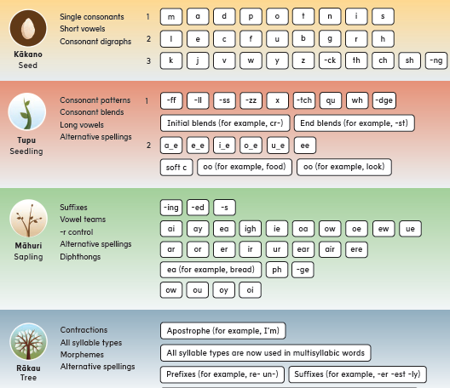
Example: Scope and sequence
An example of a phonics scope and sequence is the Ready to Read Phonics Plus one on the right.
It manages the intrinsic load by supporting a transition from simple to complex grapheme-phoneme (letter-sound) correspondences.
There is systematic sequencing of instruction of the key ‘bits’ required for learning to read.
It reduces the cognitive load by being focused on only one new element within a lesson, e.g., sh.
Notes:
A scope and sequence is not the specific order in which all students learn grapheme-phoneme correspondences, digraphs, morphemes and so on.
Learning is not linear.
For example, nearly all children learn the first letter of their name before any other.
Instead, a scope and sequence should be understood as a research-informed guide for teachers to make decisions about what the next learning step might be for any learner.
It shouldn’t be one size fits all.
Assessment, such as progress monitoring, should be used to identify what ākonga know and what they could be taught next.
In terms of the science of learning a scope and sequence manages the intrinsic load in that it guides a teacher to focus on teaching one correspondence at a time. This reduces the complexity of learning.
This systematic sequenced approach breaks the learning down to the smallest element so that in any single lesson you are focused on teaching that one feature.

Slide 35
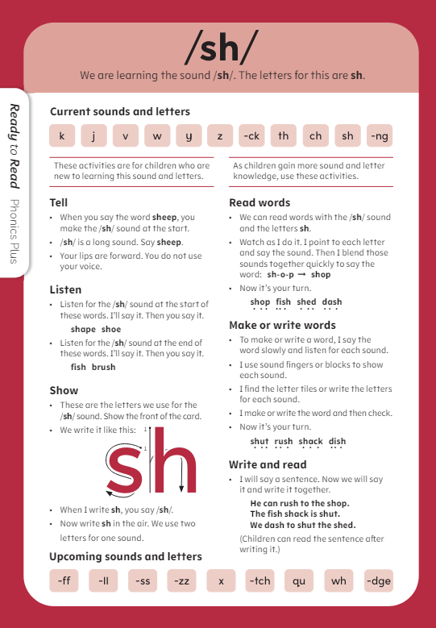
What is the Science of Learning?
Example: Phoneme-grapheme correspondences
In SLA, phonics teaching is not driven by a book but by the letter-sound relationships ākonga need to learn.
The Ready to Read Phonics Plus sound and phonics cards, along with the scope and sequence, support kaiako to break this learning down into chunks to manage ākonga cognitive load.
Ākonga systematically learn the target phoneme (sound) and corresponding grapheme (letter/s), before learning to read them in words, and make or write them.
Lastly, ākonga learn to read and write them in a sentence.
Phoneme/grapheme | Words | Sentences
sh | rush, shop | He can rush to the shop.
Notes:
If you are an English-medium primary school, you will have received the Ready to Read Phonics Plus Kākano sound cards. You may want to bring them out and explore them during this session.

Slide 36
Example: Using decodable books
Using decodable books, that include the phoneme-grapheme correspondences that ākonga have already learnt, aligns with the science of learning by:
building on prior knowledge – for example, including ‘sh’, and other previously learnt correspondences
providing retrieval practice – for example, by including lots of words with ‘sh’ in them
reducing cognitive load – for example, by:
mostly including only correspondences that ākonga have already learnt and practised in words and sentences
introducing high-frequency words, that have correspondences that ākonga haven’t learnt yet, in a manageable way.
Notes:
The benefit of a decodable text like Weka in the Shed is that enables the practice of that new learning in consistent ways so that those new words occur regularly, or those new sounds occur regularly. So in Weka in the Shed, the previous learning they are building on would be ‘sh’ as ‘ck’, and all the other sounds they have learnt earlier in the scope and sequence.
There are a number of ‘sh’ and ‘ck’ words in the text that the ākonga which provide retrieval practice. The text also contains words that have the ‘sh’ at either the beginning and the end (e.g. shed, wish), so that increases that cognitive flexibility.
In terms of reducing extraneous load, the text focuses just on that new learning and all the previous learning that has already been done.

Slide 37
Ready to Read Phonics Plus
Ready to Read Phonics Plus is the foundational instructional reading series the Ministry of Education provides for students entering school and in junior classes.
The Ready to Read Phonics Plus books and the supporting materials, provide opportunities for students to practice foundational literacy skills, such as decoding, through meaningful texts that are aligned to a structured, phonics-based scope and sequence. The books and supporting materials are distributed to all schools with students in years 1-3.
Notes:
Ready to Read Phonics Plus – Series introduction: https://newzealandcurriculum.tahurangi.education.govt.nz/ready-to-read-phonics-plus---series-introduction/5637201615.p
Ready to Read Phonics Plus Phase 1 – Kākano l Seed: https://newzealandcurriculum.tahurangi.education.govt.nz/ready-to-read-
phonics-plus-phase-1---k-kano-seed/5637200888.p
Kākano | Seed supporting materials - cards and games: https://newzealandcurriculum.tahurangi.education.govt.nz/k-kano-seed-supporting-materials---cards-and-games/5637206841.p
Ready to Read Phonics Plus Phase 2 - Tupu l Seedling: https://newzealandcurriculum.tahurangi.education.govt.nz/ready-to-read-phonics-plus-phase-2-tupu-l-seedling/5637200944.p
Tupu | Seedling supporting materials - cards and games: https://newzealandcurriculum.tahurangi.education.govt.nz/tupu-seedling-supporting-materials---cards-and-games/5637206176.p
Ready to Read Phonics Plus Phase 3 - Māhuri l Sapling Phase: https://newzealandcurriculum.tahurangi.education.govt.nz/ready-to-read-phonics-plus-phase-3---m-huri-sapling/5637203088.p
Ready to Read Phonics Plus Phase 4 - Rākau l Tree: https://newzealandcurriculum.tahurangi.education.govt.nz/ready-to-read-phonics-plus-phase-4---r-kau-l-tree/5637202340.p
Please note links must be copied & pasted into your browser

Slide 38
Ready to Read Phonics Plus
On Tāhūrangi, you can also find:
information about the series, including the scope and sequence
introductory and informative videos showing teachers working with students in classrooms
pdfs of all of the books and supporting materials.
A good place to start is here:
Ready to Read Phonics Plus – series Introduction
Notes:
Ready to Read Phonics Plus – Series introduction: https://newzealandcurriculum.tahurangi.education.govt.nz/ready-to-read-phonics-plus---series-introduction/5637201615.p
Ready to Read Phonics Plus Phase 1 – Kākano l Seed: https://newzealandcurriculum.tahurangi.education.govt.nz/ready-to-read-
phonics-plus-phase-1---k-kano-seed/5637200888.p
Kākano | Seed supporting materials - cards and games: https://newzealandcurriculum.tahurangi.education.govt.nz/k-kano-seed-supporting-materials---cards-and-games/5637206841.p
Ready to Read Phonics Plus Phase 2 - Tupu l Seedling: https://newzealandcurriculum.tahurangi.education.govt.nz/ready-to-read-phonics-plus-phase-2-tupu-l-seedling/5637200944.p
Tupu | Seedling supporting materials - cards and games: https://newzealandcurriculum.tahurangi.education.govt.nz/tupu-seedling-supporting-materials---cards-and-games/5637206176.p
Ready to Read Phonics Plus Phase 3 - Māhuri l Sapling Phase: https://newzealandcurriculum.tahurangi.education.govt.nz/ready-to-read-phonics-plus-phase-3---m-huri-sapling/5637203088.p
Ready to Read Phonics Plus Phase 4 - Rākau l Tree: https://newzealandcurriculum.tahurangi.education.govt.nz/ready-to-read-phonics-plus-phase-4---r-kau-l-tree/5637202340.p
Please note links must be copied & pasted into your browser

Slide 39
Reflection
How would a scope and sequence help you plan to meet the needs of your students?
What do you already know about the science of learning and structured literacy approaches?
What aspects of structured literacy approaches would you want to focus on and learn more about?
What do I need to consider when designing a sequence of learning to ensure that the cognitive load for my ākonga is appropriate for them?

Slide 40
Strengthening our structured approaches
What strategies and actions can we take that retain motivation and agency while ensuring we limit extraneous load?
In what ways has extraneous load crept into, or been designed into, aspects of our teaching and learning of literacy?
What tools and resources do we use currently that include/draw on scope and sequence?
What simple routines and structures are part of our practice currently? How can we make more intentional use of routines and structure to lower cognitive load on working memory for our ākonga?

Slide 41
For leaders...what is your role?
What do you know and need to know more about?
What do you need to do to support teachers in your school/kura to implement and embed structured literacy approaches?
What might your teachers need to stop doing to have the capacity to learn about and implement structured literacy approaches?

