Slide 1
Sector Forum 5 June
Please remember
Please mute yourself
Please keep questions to the end – if you’d like to ask a question please type it into the chat box
We are recording for note-taking purposes – we will email a written summary to you in the coming weeks

Slide 2
Agenda
4:00 – 4:05 - Introductions
4:05 – 4:20 - Proper maintenance of asbestos containing materials (Is high-pressure water blasting safe?)
4:20 – 4:35 - Work Requirement Notice Assistance Programme - a Ministry funded project management service to help keep your school safe
4:35 – 4:40 - Maintenance guide
4:40 – 4:45 - ​Update on school-led project processes
4:50 – 5:00 - Q&A session

Slide 3
Proper maintenance of asbestos containing materials
Is high-pressure water blasting safe?
Presented by: Craig Mansell - Principal Advisor | Asbestos Compliance and Robert McAllister - Senior Asset Manager | Asset Management

Slide 4
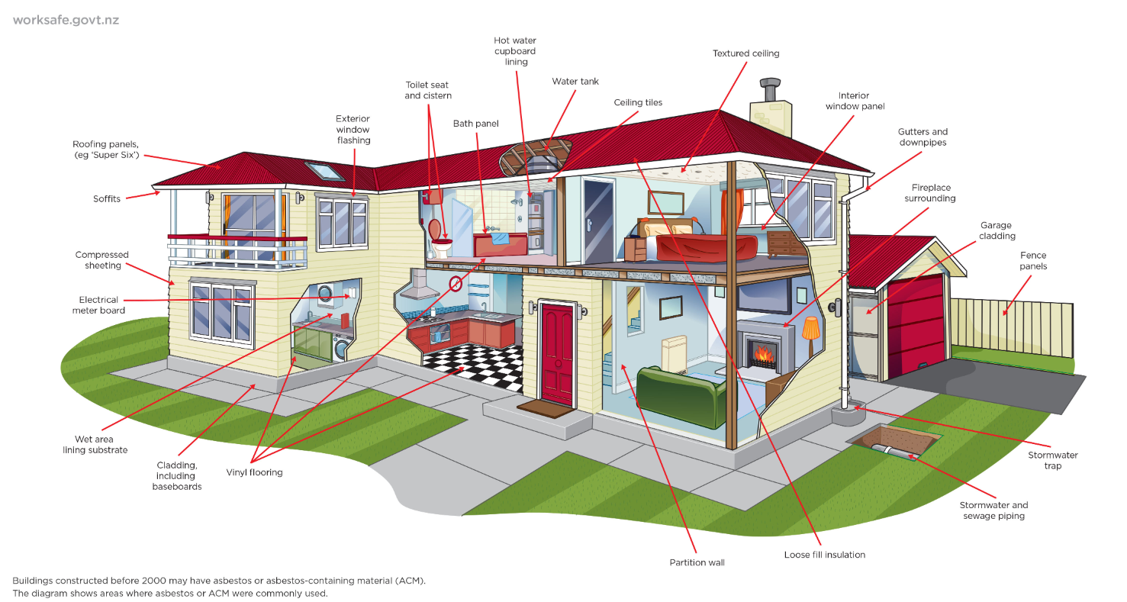
Why is there asbestos in schools?
Use of building materials containing asbestos was widespread globally until late 1990s because of
its fire resistance and insulation properties, durability, and
low cost.
Notes:
Talking points:
According to WorkSafe New Zealand (WorkSafe), ALL BUILDINGS built before 1 January 2000 are likely to contain asbestos. Given the age of our school buildings across the country, this naturally-occurring mineral might be present in some of the materials used to build some of our schools.
We appreciate that some of you who are hearing this information for the first time may find the news a bit surprising. We’d like you to note, however, that health risks from asbestos containing materials that are kept in good condition and undisturbed are low because they are unlikely to release airborne fibres that can easily be inhaled.
To keep asbestos containing materials undisturbed and in good condition, it is crucial that their location in your property are clearly identified. We encourage you to engage the services of a qualified asbestos surveyor to create your school’s Asbestos Management Plan.

Slide 5
High-pressure water blasting on asbestos
X
Health and Safety at Work (Asbestos) Regulations 2016 states that it is illegal to allow the use of high-pressure water spray on asbestos.

Slide 6
What are the risks?
Asbestos is most dangerous when it’s deteriorating, damaged or disturbed.
Cleaning asbestos containing cement roofs, fences and walls with high-pressure water spray equipment can destroy their binding matrix.
It creates airborne asbestos fibres and widespread contamination.
Disturbed asbestos fibres that resettle on surfaces stick to everything.
When dry, these fibres become highly friable and are very easily disturbed.

Slide 7
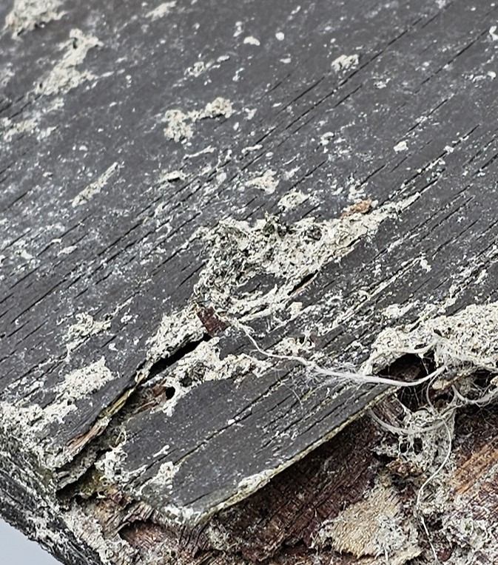
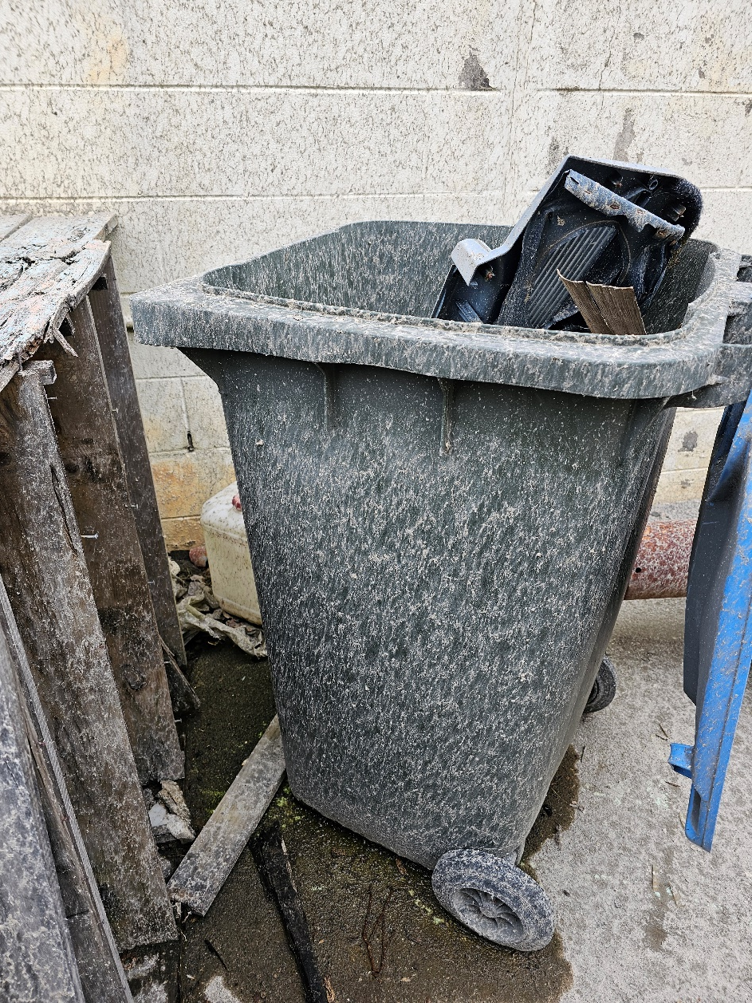
What are the risks?

Slide 8
Consequences
Significant exposure to airborne asbestos. If left unaddressed, the fibres dry and can easily become airborne which can lead to the inhalation of asbestos fibres.
Entire areas of the school may need to be closed to ensure the safety of everyone.
Huge remediation costs. The contamination can spread everywhere in to all difficult to reach places making the clean up extensive and expensive.

Slide 9
Help keep everyone safe from asbestos
Make sure all contractors are given access to the school’s Asbestos Management Plan.
Maintain a good paint finish on the asbestos containing material to prevent fibre release.
No work to be undertaken on any unsealed asbestos (e.g. unpainted asbestos containing material).
An alternative to high-pressure water blasting is to use a ‘soft wash’ option or chemical wash.

Slide 10
National Asbestos Management Programme
In 2022, the Ministry conducted a national audit of current Asbestos Management Plans (AMPs) held by our schools.
The audit highlighted the need to undertake a program that assists schools in the production of a compliant AMP.
In September 2023, the National Asbestos Management Programme (NAMP) was approved by the Investment Board.

Slide 11
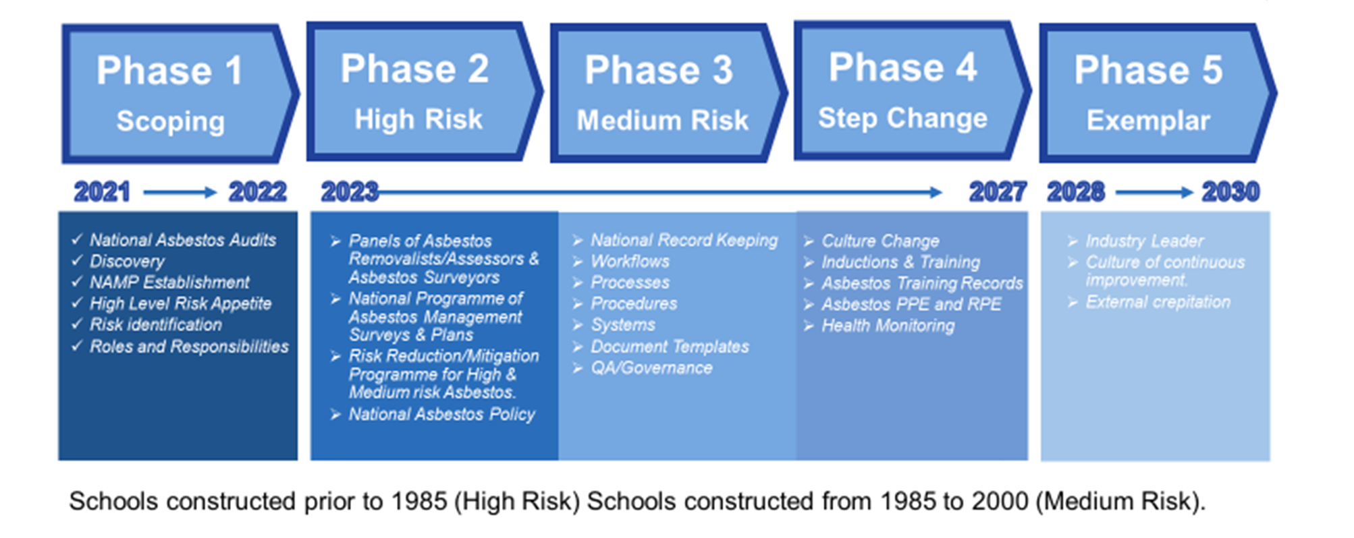
National Asbestos Management Programme

Slide 12
National Asbestos Management Programme
High Risk ACM
Produce Asbestos Management Plans for schools that do not currently have one.
NOT an asbestos removal programme. It aims to prioritise management and monitoring of Medium Risk to High Risk asbestos containing materials (ACMs).
Establish an approved list of qualified asbestos consultants and removalists that the Ministry and schools can engage.
Improve policy, guidance and processes by standardising the approach to asbestos management in schools.
Medium Risk ACM
Low Risk ACM
Very Low Risk ACM

Slide 13
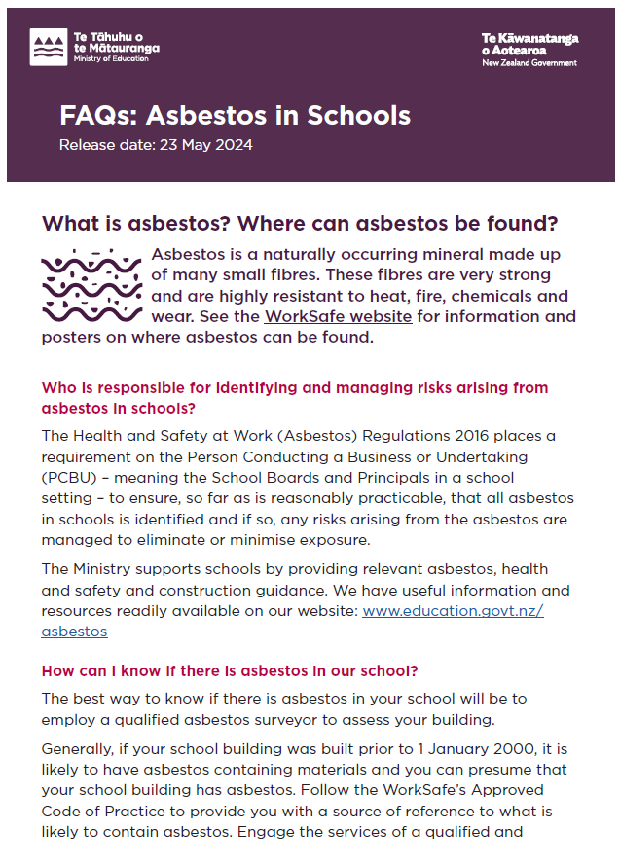
For more information and resources
Visit our website: www.education.govt.nz/asbestos
Email us:
TPHM.HealthandSafety@education.govt.nz

Slide 14
Work Requirement Notice Assistance Programme
A Ministry funded project management service to help keep your school safe ​
Presented by: Erin Stephen - Manager Ownership and Occupancy | Property Delivery

Slide 15
Making sure that school buildings are safe
People can escape if there is a fire.
Lifts are well maintained, and if someone is trapped we get them out fast.
Boilers work and are safe to operate
Automatic doors will open.
Fire escape are not locked or obstructed.
Alarms work.
Escape signage is clear.
Evacuation plans are up to date.
Due diligence over building safety
Is the water safe to drink? Is it being tested, are problems being fixed?
Are schools checking building components regularly?

Slide 16
Key responsibilities
The Ministry is the building owner
The Ministry is responsible for funding building compliance & administering the system
The Board is the building occupant
Receive funding (5YA & PMG) and services from the Ministry to enable compliance
Under the Property Occupancy Document, responsible for ensuring the buildings are compliant
Argest is the Ministry’s agent
Organises subcontractors to deliver services
Keeps track of timelines & administers the system
Is primary contact for Councils

Slide 17
Working together to keep school buildings safe
155,393 assets inspected
3,800+ WRNs issued and closed
2,100+ BWOFs issued

Slide 18
May – July is the busy time of year
Approx 50% of BWOFs are due in this 3-month period. This affects the whole country, not just schools.
There is limited capacity in the industry during this period.
The earliest the annual inspection can be done is 6 weeks before the due date.
Some issues take months to fix. Nationwide industry capacity issues can make this take even longer.
If your school has been issued a WRN you need to act quickly to make your school safe.
We are here

Slide 19
WRN Assistance Programme – we can help
Argest will project manage your WRN remediation projects for free.
Argest will:
Define the scope of the WRN.
Prepare tender documents (if req).
Use your preferred suppliers (if any).
Manage the delivery of the project.
Get the work reinspected and the WRN closed.
School pays the suppliers from 5YA or PMG.
Ministry pays Argest for the project management service.
TeamMOE@argest.com

Slide 20
Tracking school performance
The State School Property Occupancy Document (the POD) is the lease agreement between the Ministry and school boards.
Boards are required under the POD to participate in building compliance and are responsible for carrying out any remedial work required.
Argest tracks school performance on building compliance.
We are progressively expanding the WRN Assistance Programme.
A history of poor performance managing WRNs may lead to mandatory use of the WRN Assistance Programme in the future, to ensure that boards are meeting their obligations under the legislation and the POD.

Slide 21
Consequences of non-compliance
Someone could be hurt.
Fines for non-compliance.
Up to $200k for failure to comply with a Notice to Fix + $20k per day the offence is continued.
Up to $100k for continued use of a building which is dangerous or unsanitary + $10k per day the offence is continued.
School closure.
FENZ can close the school if the fire systems are not working (i.e. have an open WRN)
The Council can also close the school as part of its fine escalation process.
Prosecution by Worksafe after an event.
Building compliance failures would be relevant evidence of H&S failures.
Can include personal fines and prison sentences.

Slide 22
Learn more
Essential reading for everyone:
https://www.argest.com/services/schools/
https://www.education.govt.nz/school/property-and-transport/maintenance-repairs-security/building-warrants-of-fitness/
TeamMOE@argest.com, 0800 274 378
Contact your Property Advisor.
For enthusiasts:
https://www.education.govt.nz/school/property-and-transport/projects-and-design/design/design-standards/fire-safety-design
https://www.education.govt.nz/school/property-and-transport/roles/state-schools/
https://www.building.govt.nz/managing-buildings/managing-your-bwof/inspection-and-maintenance-of-specified-systems
https://www.building.govt.nz/managing-buildings/managing-your-bwof/fines-and-penalties

Slide 23
Maintenance guide
Presented by: Anthea Morell - Team Leader | Operational Practice​
​

Slide 24
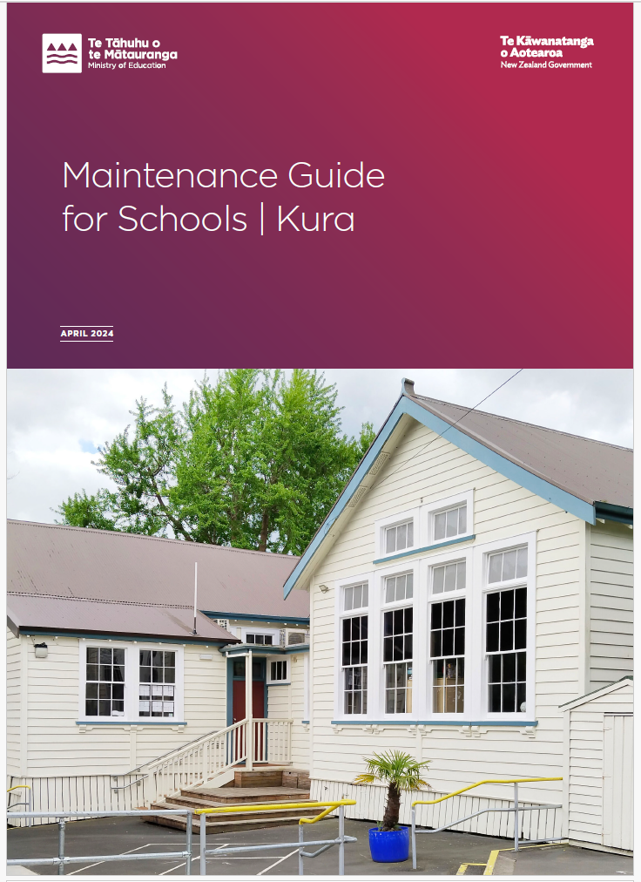
Maintenance Guide for Schools
Ministry worked with BRANZ to develop new Maintenance Guide for Schools |Kura
It can be found on the website: Property Maintenance page. Read online or download for reference and printing
Audience - school leaders, boards, and caretakers
Comprehensive guidance on how to plan and carry out regular maintenance of building exteriors
Includes templates for you to adapt and develop your own maintenance plan

Slide 25
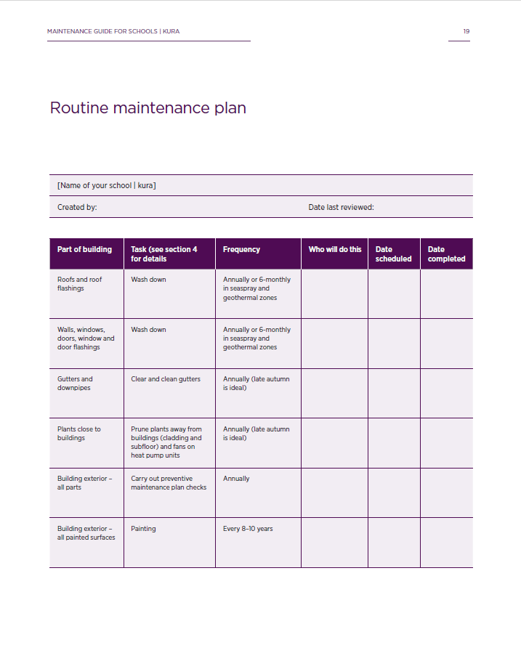
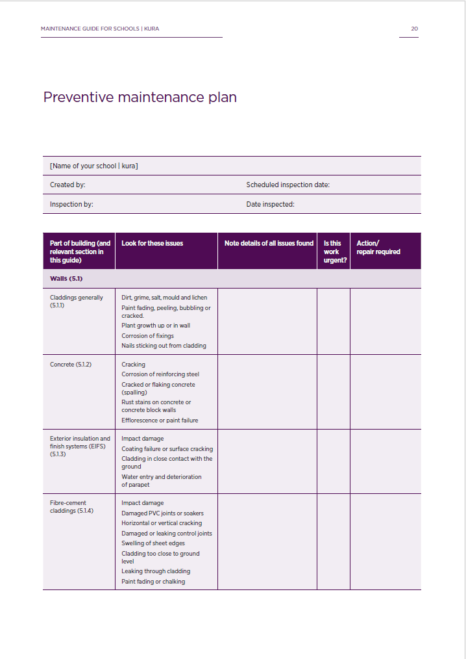
Maintenance Plan Template

Slide 26
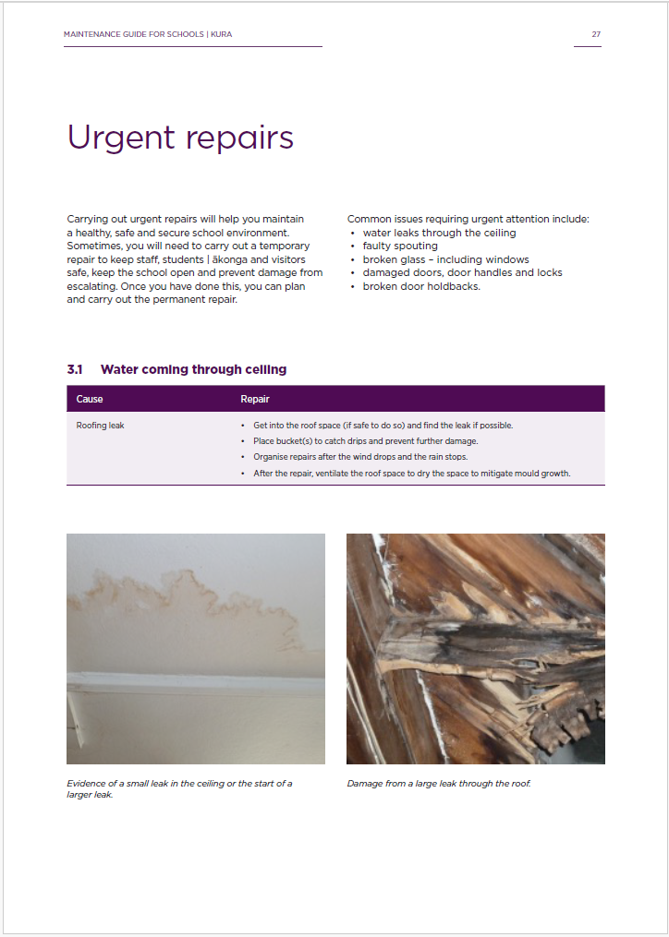
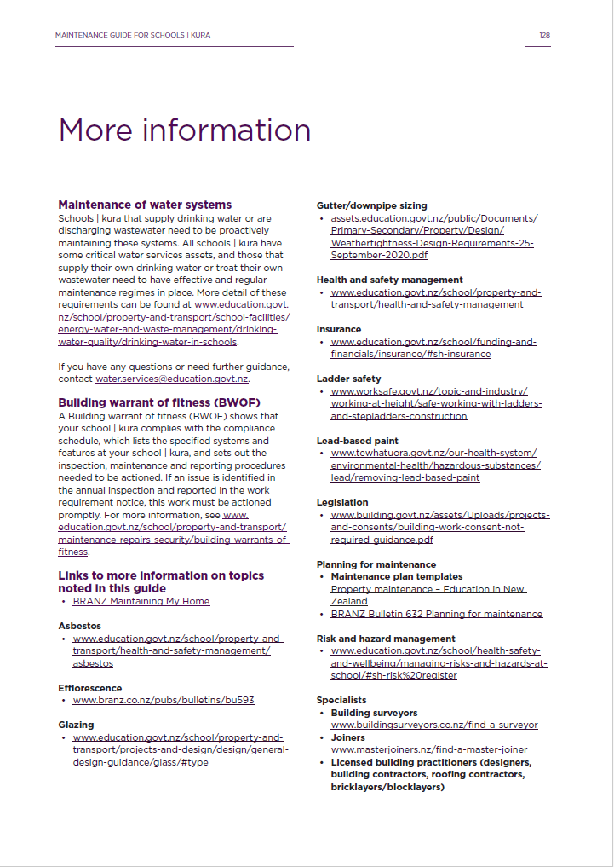
Maintenance Guide design

Slide 27
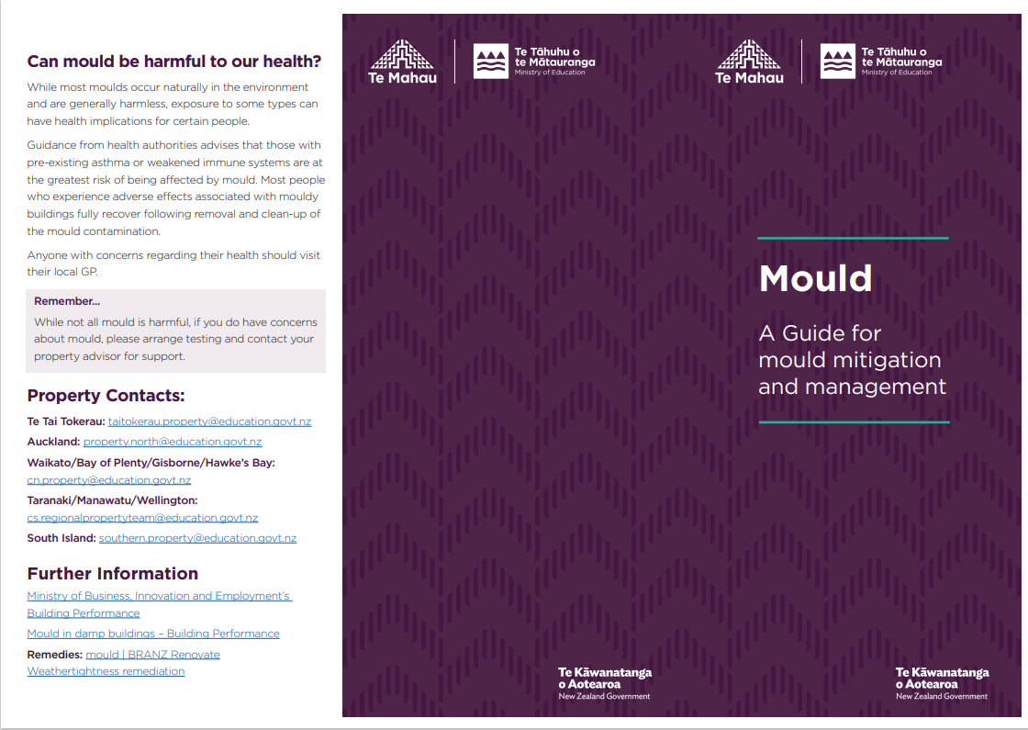
Health and Safety – Moulds and Fungi
Mould and fungi can grow more easily during winter months with the elevated moisture levels in the air. It is recommended to clean more frequently during this period.
The ministry has published - A Guide for mould mitigation and management
Mitigating-Mould-DLE-Brochure.pdf (education.govt.nz)
For advice and guidance:
refer to the ministry website Moulds and fungi – Education in New Zealand
contact the ministry regional mailbox or your property advisor

Slide 28
Update on school-led project processes
Presented by: Anthea Morell - Team Leader | Operational Practice​

Slide 29
Approval of school-led projects
The use of Salesforce for school-led projects has been paused due to feedback from schools and project managers.
School-led opening and closing documentation is now completed using the templates on the website as per the previous process. Project management forms – Education in New Zealand
Email completed forms to the regional shared mailbox. Your project manager will know how to complete project forms.
Questions: Talk to your Property Advisor, or email PPMProject.Mailbox@education.govt.nz
When a project is approved by the Ministry, up to 90% of the project budget is paid to the Board
Fees release process is unchanged (for projects over $100K)

Slide 30
Process for managing property projects
All school-led projects need to be approved by us prior to commencement – no retrospective approval or reimbursements
Contractor must be appointed using the standard Ministry construction contract
Retentions – when holding retentions for construction projects you have to comply with the new requirements of the 2023 Amendment Act (from 5 October 2023)
Information-for-schools-Construction-Contract-Retention-Money-Amendment-Act-2023.pdf (education.govt.nz)
Variations - within the approved budget must be approved and signed by the Board
During a project, if any concerns regarding budget or scope are identified contact your Property Advisor for guidance

Slide 31
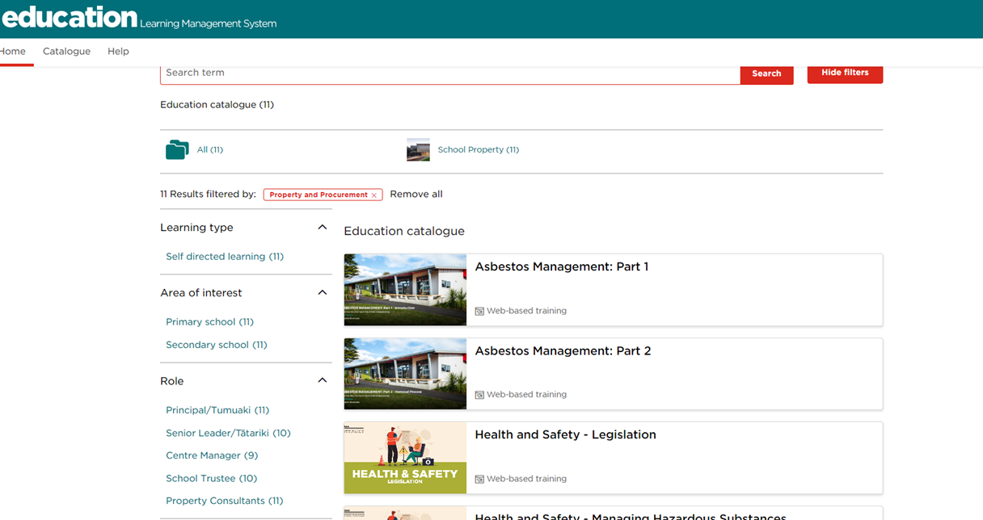
School training modules
Suite of training modules to support school leaders and external consultants to understand our processes and practices and their responsibilities and obligations for school property.
External-facing Education Learning
Management System (LMS) at
training.education.govt.nz
Benefits:
Easier access
Users can log in with their Education
Sector Logon (ESL) or as a guest user.
Access modules via the catalogue
Learn in your own time
Ability to review modules later.

Slide 32
School module topics
Topic | Module | Audience
Property Planning and Funding | Property Planning and 5YA Funding for your kura Other property projects and funding | Tumuaki and Board Members
Property Projects | Managing Kura | School-led Projects Property Design Standards Kura | School-led Project Management Forms | Tumuaki and Board Members School Project Managers
Health and Safety for School Leaders | Legislation Roles and Responsibilities Managing Risks and Hazards Managing Hazardous Substances | Tumuaki and Board Members
Property Maintenance | Day-to-Day Maintenance Compliance Fire Safety | Tumuaki and Board Members
Other | Leasing and Hiring School Property Emergency Management | Tumuaki and Board Members

Slide 33
Closing school-led projects
Importance of closing projects
Ensure Board is paid total project funding
Check that projects requiring consent have a Code Compliance Certificate (CCC)
Update building information
Send closing docs to Ministry when final payment made to contractor (or final claim amount is known)
Submit the following:
Construction Observation Certificate
Occupancy Use Certificate
Helios Asset Update Form Final: Project Financial Information for School Buildings
Plant Ancillary Site Financials
Building Update Form (If required)
Evidence of final project costs (invoices, payment clams)
Some funding programmes have a set end date
Important that final payments made to Board and projects closed
Programmes include School Investment Package (SIP) and Learning Support Coordinator (LSC) funding
Talk to Property Advisor if funds not paid or project not complete
Notes:
Close out process is very little change without using Salesforce – same project forms, school invoice.
These forms cover the information we need to meet legal and accounting requirements for a capital building project, and the documentation needed for audit purposes.

Slide 34
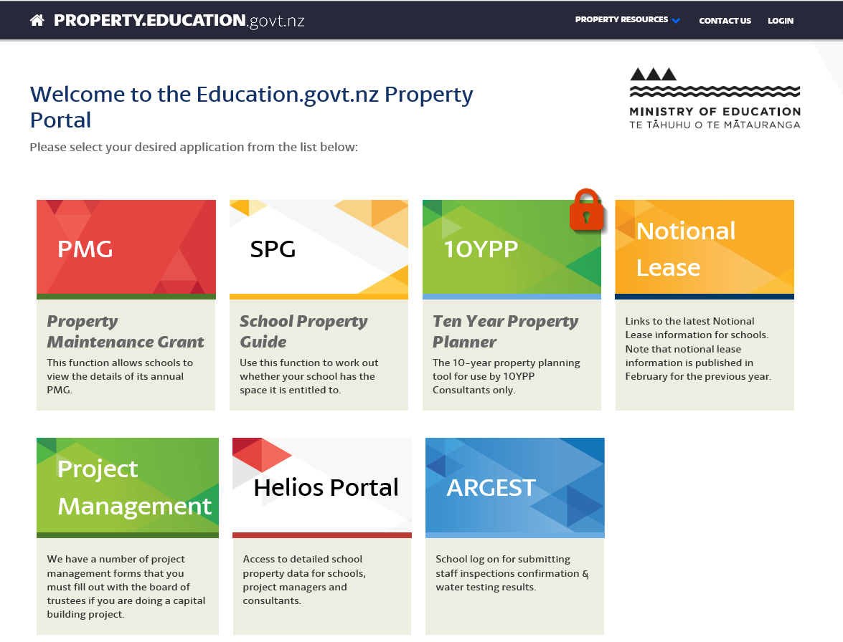
Notes:
Argest portal
Website for schools, Project Managers, 10YPP consultants, Property Administrators to interact with the Ministry’s asset management tool (K2)
Helios replaces ‘PMIS’ (Property Management Information System)
The Helios portal includes:
Building and site data
Site plans
Programme and project data
Future property plans
The Ten Year Property Planner is an online application for 10YPP consultants to develop a capital work plan for the next 5 and 10 year periods

Slide 35
Pātai - Questions

